Slide 1
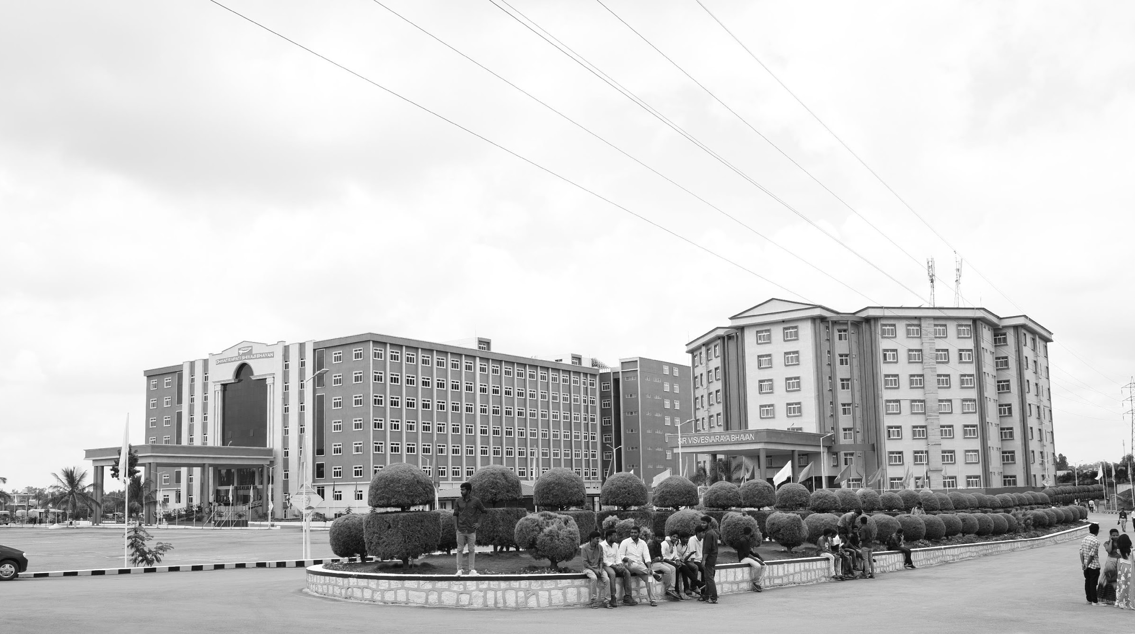

Adaptive modulation in optical fiber communication
AY 2021-25
GITAM UNIVERSITY
Major Project
Project ID: Alpha 24
A University should be a place of light, of liberty, and of learning.
Department of Electrical Electronics and Communication Engineering
Project Team:
SURYA TEJA J
B M K GANESH
G HEMANTH KUMAR
Project Mentor: Dr.Rohan Prasad
www.gitamedu.com

Slide 2




Project Group – Details
Photo
Track
Roll No
Name
Photo
ECE
BU21EECE0100544
SURYA TEJA J
ECE
BU21EECE0100519
B M K GANESH
Photo
ECE
BU21EECE0100514
G HEMANTH KUMAR

Slide 3
Objective and Goals
Design and Simulation: Develop a robust QPSK modulation scheme in OptiSystem to achieve a bit rate of 40 GHz over 50 km.
Performance Evaluation: Analyze key metrics such as Bit Error Rate (BER), Signal-to-Noise Ratio (SNR), and eye diagrams to assess QPSK effectiveness.
Dispersion and Attenuation Analysis: Evaluate the impact of chromatic dispersion and attenuation, exploring compensation techniques.
Comparison with Other Modulation Techniques: Benchmark QPSK performance against BPSK and QAM regarding efficiency and reliability.
Recommendations for Future Work: Suggest future research directions and potential system design improvements.
Objective
Goals
Main Goals
Achieve a bit rate of 40 GHz over 50 km of fiber optic cable.
Evaluate the performance metrics: Bit Error Rate (BER), Signal-to-Noise Ratio (SNR).
Additional Goals
Analyze the impact of dispersion and attenuation on signal quality.
Compare QPSK with other modulation techniques like BPSK and QAM.

Slide 4
Literature Survey
-Author : Yequn Zhang and Ivan B. Djordjevic. -Established in year 2013. | Adaptive Modulation Implementation DWDM System Optimization Adaptive Trellis-Coded Modulation (ATCM) Performance Evaluation BER Integration | Increased Complexity: Adaptive systems require sophisticated algorithms and hardware, raising implementation complexity. Hardware Cost: Support for multiple modulation formats can increase the cost of DACs and DSP components. Power Consumption: Adaptive systems may consume more power due to dynamic adjustments and processing. Error Handling: Adaptation may complicate error handling and recovery processes. System Stability: Frequent modulation changes can affect system stability and performance consistency.
Author and Established year Methodology Drawbacks

Slide 5
Literature Survey
Authors: Xiaofeng Gao, Feng Tian, Qi Zhang, Qinghua Tian, Yongjun Wang, Leijing Yang, Xiangjun Xin Established Year: 2021 | Multi-Carrier Utilization: Employ FFT/IFFT to manage subcarriers, enhancing spectral efficiency. Dynamic Allocation: Adjust bit and power allocation in real-time based on channel conditions. Adaptive Modulation: Modify transmission parameters to optimize performance per channel band. Bit Allocation: Apply Hughes-Hartogs algorithm for efficient bit and power distribution. | Complexity: Adaptive modulation increases system complexity and computational load. Latency: Real-time adjustments may introduce latency. Cost: Advanced technology can lead to higher implementation costs. Compatibility: May not be compatible with existing infrastructure. Error Handling: Sensitive to noise and signal degradation in various bands.
Author and Established year Methodology Drawbacks

Slide 6
Literature Survey
S. Thompson et al. (2008) on coherent optical OFDM, published in Journal of Optical Networking Jansen et al. (2007) on 10 Gb/s OFDM with conventional DFB lasers from the Proceedings of ECOC A. Lamary et al.'s work on adaptive dispersion compensation, which lacks a specified year; A. Ali et al. (2007) on optical biasing in direct detection OFDM, also from ECOC 2007; S. Thompson et al. (2008) on constant envelope OFDM in IEEE Transaction on Communications; A. L. Suva et al. (2010) on direct-detection CE-OFDM at SPPCom; and X. Zheng et al. (2010) on phase modulation at ECOC. | Phase Modulation: Optical signal modulated with phase to maintain a constant envelope. QPSK modulation scheme Signal Processing: Applies inverse FFT for demodulation and equalization. Nonlinear Analysis: Evaluates performance over nonlinear fiber links. Phase Noise Management: Manages phase noise by leaving subcarriers empty. | Complexity in Phase Modulation: Increased setup complexity. Nonlinear Effects: Limited tolerance to high power. Spectral Efficiency: Reduced compared to traditional methods. Phase Noise Residuals: Residual effects require careful management. Optical Spectrum: Out-of-band emission challenges.
Author and Established year Methodology Drawbacks

Slide 7
Analysis - SWOT
Strengths
Weaknesses
W1. Complexity in modulation and demodulation.
W2. Susceptibility to dispersion over long distances.
S1. High efficiency in bandwidth utilization.
S2. Robust performance in noise environments.
Threats
T1. Competition from alternative technologies (e.g., 5G).
T2. Rapid advancements in modulation techniques.
Opportunities
W1. Complexity in modulation and demodulation.
W2. Susceptibility to dispersion over long distances.

Slide 8
Analysis – 4W1H
Why: Increasing demand for high-speed, reliable data transmission.
What: QPSK modulation technique in fiber optics.
Where: Applied in telecommunications, data centers, and high-speed networks.
When: Current context of rising data traffic and IoT growth.
How: Through simulation and performance analysis using OptiSystem.
Refined Objective: To provide a practical implementation of QPSK that overcomes existing challenges in long-distance transmission.

Slide 9
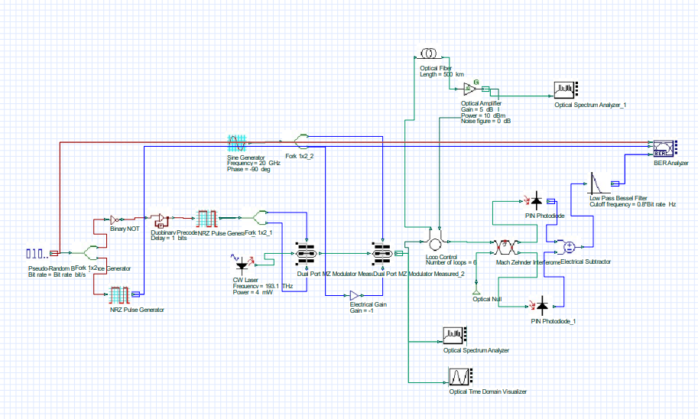
Architecture

Slide 10
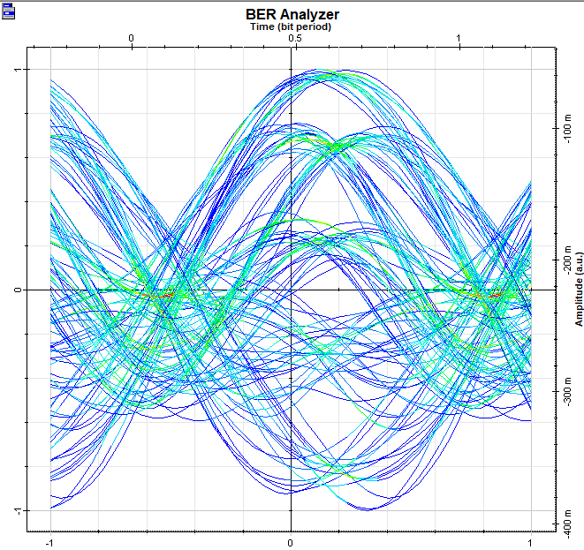
Use Cases & Testing
Use Cases
High-speed internet service providers.
Data transmission in metropolitan networks.
Applications in IoT and smart cities.
Test Cases
Performance under varying distances (up to 50 km).
Impact of different noise levels on BER.
Comparison of QPSK with BPSK and QAM under the same conditions.

Slide 11
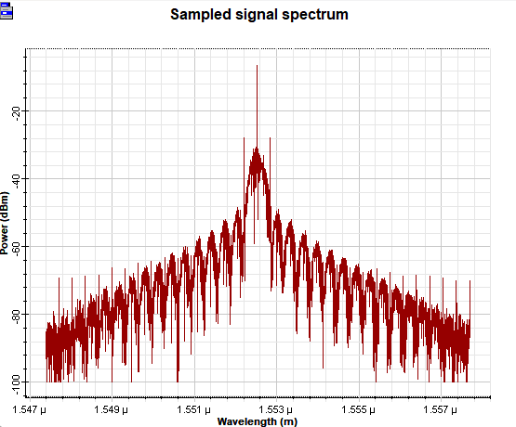
Implementation and Results – Iteration 1
Iteration 1 : Results
Summary of simulation outcomes:
BER results and graphical representations (eye diagrams, constellation diagrams).
SNR measurements across distances.
Performance comparison with other modulation techniques.

Slide 12
Conclusion & Future Work
Summary and Conclusion
Recap of objectives and findings.
Effectiveness of QPSK modulation for high-speed fiber optic communication.
Contribution to the field of optical communications.
Future Work
Exploration of higher bit rates beyond 40 GHz.
Investigating advanced dispersion compensation techniques.
Development of hybrid modulation schemes to enhance performance.

Slide 13

THANK YOU

